Slide 1
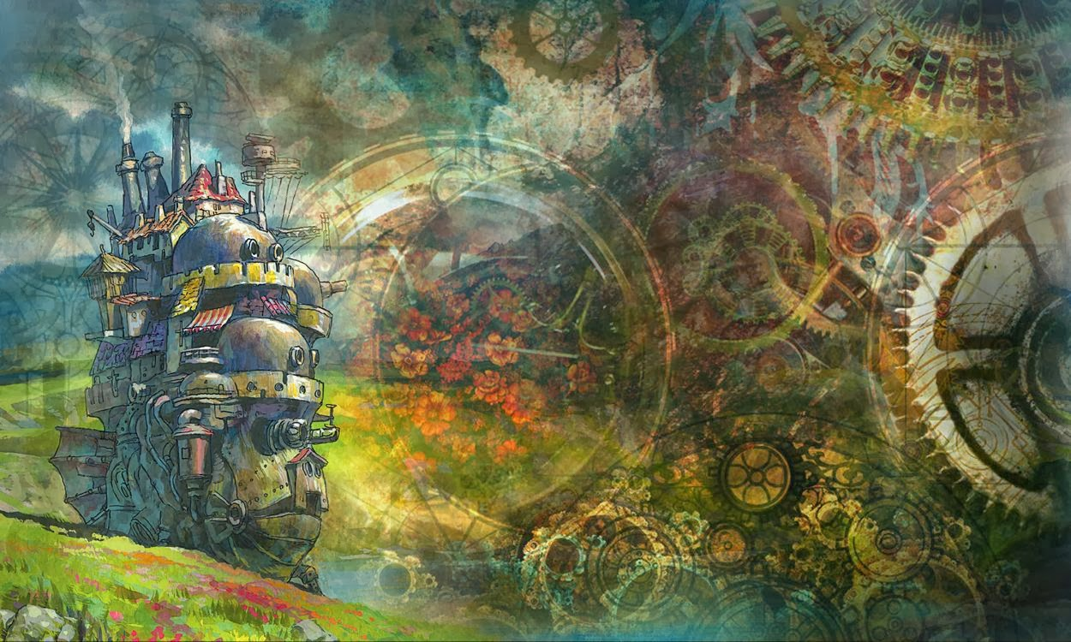
Howl’s Moving Castle: Betrayal vs Personal Integrity
Elizabeth Jacob and Rebecca Ritchie

Slide 2
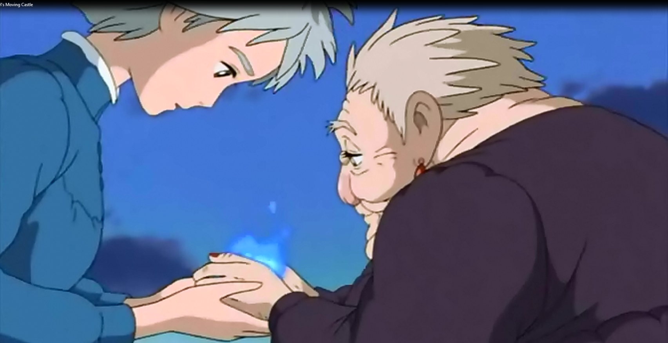

Slide 3
Introduction
Militarism is prevalent in many countries, and often results in conflict between nations. The mise-en-scene uses visual techniques to portray the idea of betrayal vs personal integrity. The fantasy/drama film Howl’s Moving Castle was directed by Hayao Miyazaki. Integrity can be defined as the quality of being honest and having strong moral principles. Howl’s Moving Castle follows the protagonist, Sophie, and her journey to rid herself of a curse placed upon her, and sees her form relationships with other cursed and magical beings. In relation to militarism, Howl’s Moving Castle can be linked to the non-fiction picture book, My Hiroshima, by Junko Morimoto. With Miyazaki’s direction, the film successfully creates a dominant perception of the text, and this is produced by the utilisation of technical codes, symbolism, and body composition.

Slide 4
Impact of structural choices on shaping own and others’ interpretations
The mise-en-scene specifically positions Sophie and the Witch of the Waste to shape the interpretations made by the viewers. Both characters are shown looking down, towards Calcifer, revealed to be Howl’s heart, with Sophie’s hands clasping those of the Witch’s. Sophie has lowered herself, making herself more equal to the Witch, which reflects how she feels about herself. She is humble, and has strong moral values. This scene also shows how the Witch has changed, as she had originally betrayed Howl and Sophie by stealing Calcifer, but with Sophie’s encouragement, she chooses to do what was best for everyone else, and return Howl’s heart, showing her integrity. By returning Howl’s heart, she is saving Howl, freeing Calcifer, and indirectly stopping the war.

Slide 5
Ways that ideas, attitudes, and voices are represented
One of the main ideas represented in the text is that of betrayal v personal integrity. The mise-en-scene uses symbolism, gaze, and body language to show this idea. Sophie and the Witch of the Waste are holding Calcifer in their hands, who represents Howl’s heart, and his weakness is the reason for Howl’s weakness, as they are directly linked. Their gaze is towards Calcifer, as he is the only counterpart they have in common, with helping Howl being their main focus. Sophie is a forgiving character, and because of this, she is willing to forgive the Witch and convince her to do the right thing.

Slide 6
Changing responses to the text over time in different cultural contexts
Responses of ‘Howls Moving Castle’ can vary over time in different cultures from the themes presented within, these being militarism and nationalism. This visual text is set in a fictional kingdom called Ingary, which does not reflect a real place but the occurrences of the war and bombing are similar to the events of many major wars. This could be interpreted in different ways by different cultures. The western world could see what is being portrayed as a romantic gesture, whereas other cultures, particularly the Japanese, could see it as a sign of weakness on the Witch’s part.

Slide 7
How and why the text positions viewers
It positions viewers to feel pity for the witch of the waste as Howl was her only love throughout her entire life. This is shown by the body positioning of the characters in this mise-en-scene, with The Witch of the Waste looking old and frail and Sophie looking younger and powerful. Sophie is higher than the Witch, which symbolises her having the advantage of the situation, and her showing more sensibility. The Witch is lower than Sophie as this shows her giving up for the sake of Howl’s well-being.

Slide 8
How anime films use different text types that shapes audience responses
Anime can be defined as a style of Japanese film/television animation. As Howl’s Moving Castle is an anime production, it can influence particular societies over others, especially Japanese. The mise-en-scene uses different types of production types, being created digitally, but being altered to look hand drawn. The characters have a solid black outline, while the background looks painted, using softer lines. Calcifer uses blurred lines which are a darker shade than his normal colour, which almost solidifies him as an actual heart, rather than just a fire demon. These are all used to individualise each aspect of the image.

Slide 9
Conclusion
To conclude, all of these points reflect the idea of betrayal v personal integrity in the mise-en-scene. Using technical codes, symbolism, and body positioning, Sophie is made to be the ultimate protagonist, and a role model, and it shows a turning point for the Witch of the Waste.
Thank you for listening to our presentation.

